Slide 1

McGraw-Hill Technology Education
Copyright © 2006 by The McGraw-Hill Companies, Inc. All rights reserved.

Slide 2
Chapter 13B
Programming Languages and the Programming Process

Slide 3
Programming Languages
Used to generate source code
Avoids using machine code
Have strict rules of syntax
  Symbols and punctuation have meaning
  Spelling must be exact
Code is converted into machine language
Notes:
Insider information
Older languages such as COBOL and Fortran actually required developers to place different coding statements in different columns on the screen.

Slide 4
Language Categories
First generation language
  Machine languages
  Written in binary
  Different for every CPU

Slide 5
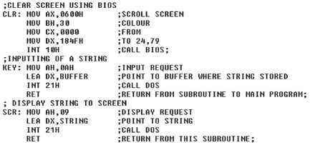
Language Categories
Second generation languages
  Assembly languages
  Statements that represent machine code
  Code converted by an assembler
  Still used to optimize video games

Slide 6
Language Categories
Third generation languages (3GL)
  First higher level language
  Supports structured and OOP
    Code is reusable
    Code is portable
  Typically written in an IDE
  C/C++ creates games and applications
  Java creates web applets
  ActiveX creates Web and Windows applets

Slide 7
Language Categories
Fourth generation languages (4GL)
  Easier to use than 3GL
  Coded in a visual IDE
  Tools reduce the amount of code
  Object oriented programming
  Microsoft .Net is a language
  Dream Weaver is an 4GL IDE

Slide 8
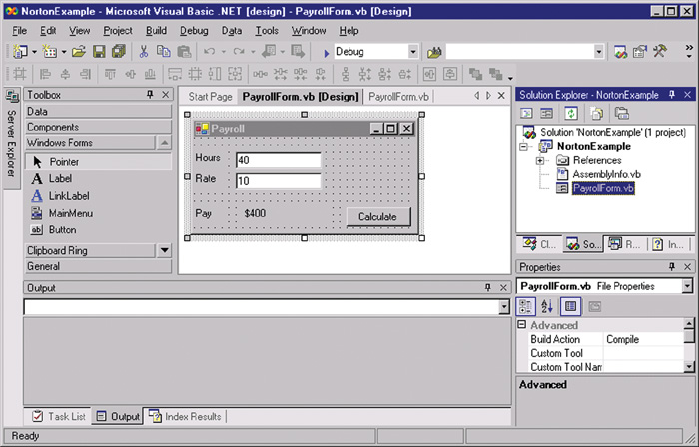
Microsoft.NET

Slide 9
Language Categories
Fifth generation language (5GL)
  Mystery language
  May not be created yet
  Will create software automatically

Slide 10
WWW Development Languages
Markup languages
  Describe how the text is formatted
Hyper Text Markup Language (HTML)
  Basis of all web pages
  Defines web structure using tags
  Easy to learn and use
  Created with a text editor

Slide 11
WWW Development Languages
Extensible Markup Language (XML)
  Stores data in a readable format
  Looks like HTML
  Allows developers to create tags
  Depends on HTML for formatting

Slide 12
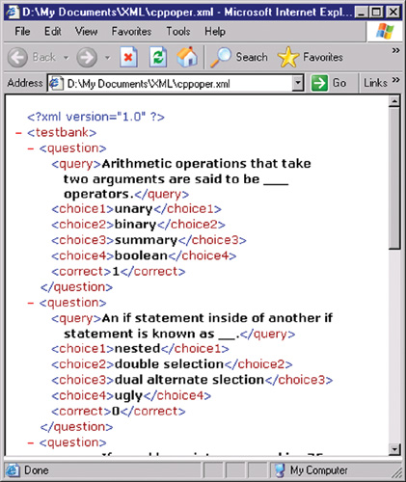
XML

Slide 13
WWW Development Languages
Extensible HTML (XHTML)
  Newer version of HTML
  Stricter rules
  Based on XML rules
Notes:
Teaching tip
Be sure to emphasize that all web technologies at some point need HTML or XHTML to present data in a browser.

Slide 14
WWW Development Languages
Extensible Style Sheet Language (XSL)
  Format and displays XML documents
  Rules that dictate formatting
  Create a standard web page

Slide 15
WWW Development Languages
Extensible HTML Mobile Profile
  XHTML MP
  Initially Wireless Markup Language (WML)
  Creates pages viewable on a handheld

Slide 16
WWW Development Languages
Cascading Style Sheets (CSS)
  Format HTML, XHTML and XSL
  Applies consistent formatting to all pages
Notes:
Teaching tip
Students wishing to learn about the web technologies should visit www.w3schools.com. W3schools.com offers several free tutorials covering nearly every mainstream web technology.

Slide 17
WWW Development Languages
Web authoring environments
  Reduces tedium for creating pages
  Tools that simplify web site creation
  Macromedia Dream weaver
    Simplifies large sites
    CSS support is exceptional
  Microsoft FrontPage simplifies large sites
  Macromedia Flash creates web animations
Notes:
Teaching tip
For a fun example of what Flash can do, check out www.homestarrunner.com and watch the exploits of Strong Bad.

Slide 18
WWW Development Languages
Scripting languages
  Create dynamic web pages
    Change based on user input
  HTML can create static pages
  Page is generated as needed

Slide 19
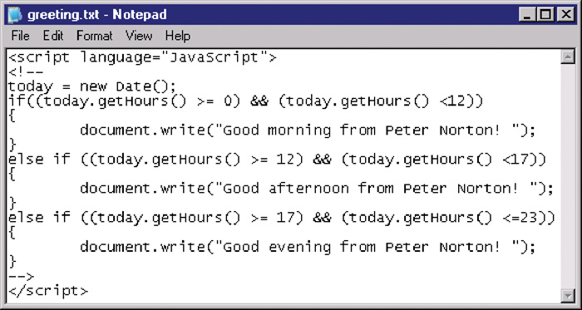
WWW Development Languages
JavaScript
  Developed by Netscape
  Works inside of HTML
  Page verification and simple animation
  Based on Java

Slide 20
WWW Development Languages
Active Server Pages (ASP)
  Developed by Microsoft
  Based on Visual Basic
  Good at connecting to Microsoft databases
  Runs only on Microsoft servers

Slide 21
WWW Development Languages
Perl
  Old UNIX language
  Found on all Windows and Linux servers
  Excellent web scripting language

Slide 22
WWW Development Languages
Hypertext Pre-Processor (PHP)
  Especially good at connecting to MySQL
  Very popular language
  Runs on UNIX and Windows

Slide 23
Systems Development Life Cycle
SDLC
Organized way to build programs
Consists of five phases

Slide 24
Systems Development Life Cycle
Phase 1: Needs Analysis
  Users identify a need
  Need is clearly defined using tools

Slide 25
Systems Development Life Cycle
Phase 2: Systems design
  Solution to the need is defined
  Many tools are used
  Prototypes of the solution are built

Slide 26
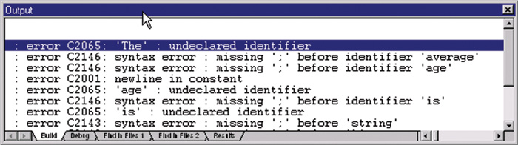
Systems Development Life Cycle
Phase 3: Development
  Solution to the problem is built
  Programmers write the solution
  Technical writers document the process
  Solution is continually tested

Slide 27
Systems Development Life Cycle
Phase 4: Implementation
  The solution is installed
  Users are converted to the new system
  Trainers are important in this phase

Slide 28
Systems Development Life Cycle
Phase 5: Maintenance
  IT professionals monitor the product
  Bugs are found and fixed
  New features are added

Slide 29
Chapter 13B
End of Chapter

